Slide 1
Bristol Datathon: Exploring the UK Fintech Sector
Authors: Gabriel Adam Pierzynski; Thomas Carey-Wilson; Timothy Monteath; Giovanni Maria Pala; Kelly Yubini.

Slide 2
Goal
Identify the different sub-classes (industries) within Financial Services and highlight the websites that provide Fintech services.
Dataset credit: (Castro Gonzalez & Tranos, 2025; Common Crawl Foundation, 2025)

Slide 3
Methodology
Different model sizes, types
Few shots vs zero shot prompting
etc.
Experimentation
FINSERV or NOT FINSERV?
K-means clustering w/ PCA (validation)
FINTECH or NOT FINTECH?
Results / Geocoding

Slide 4
Methodology
Methods:
1. We classified all 14,798 landing webpages using an LLM-based approach. The dataset was processed with Ollama, running the Gemma 3 model locally. We designed a binary classification prompt that instructed the model to determine whether each webpage corresponded to two sequential rounds of classification (following by K-means clustering for validation):
Round 1:
Financial services or
Non-financial services
Round 2:
Fintech company or
Non-fintech company

Slide 5
Methodology
Methods 2:
1. To test the validity of financial services firms being captured by the CommonCrawl data, we cross matched domain and postcode information to the Financial Conduct Authority.
We used domains from the CommonCrawl as entity names to cross match to FCA records. This resulted in 3256 matches. (We also tried using GLiNER2 model for entity extraction from the webtext, but we did not get final results in time). FCA records could then be validated by cross-matching postcodes between the two datasets. This resulted in 1586 confirmed matches.
Limitations: Time and space discrepancies between CC and FCA data and lack of clear legal/entity name for matching to FCA data

Slide 6
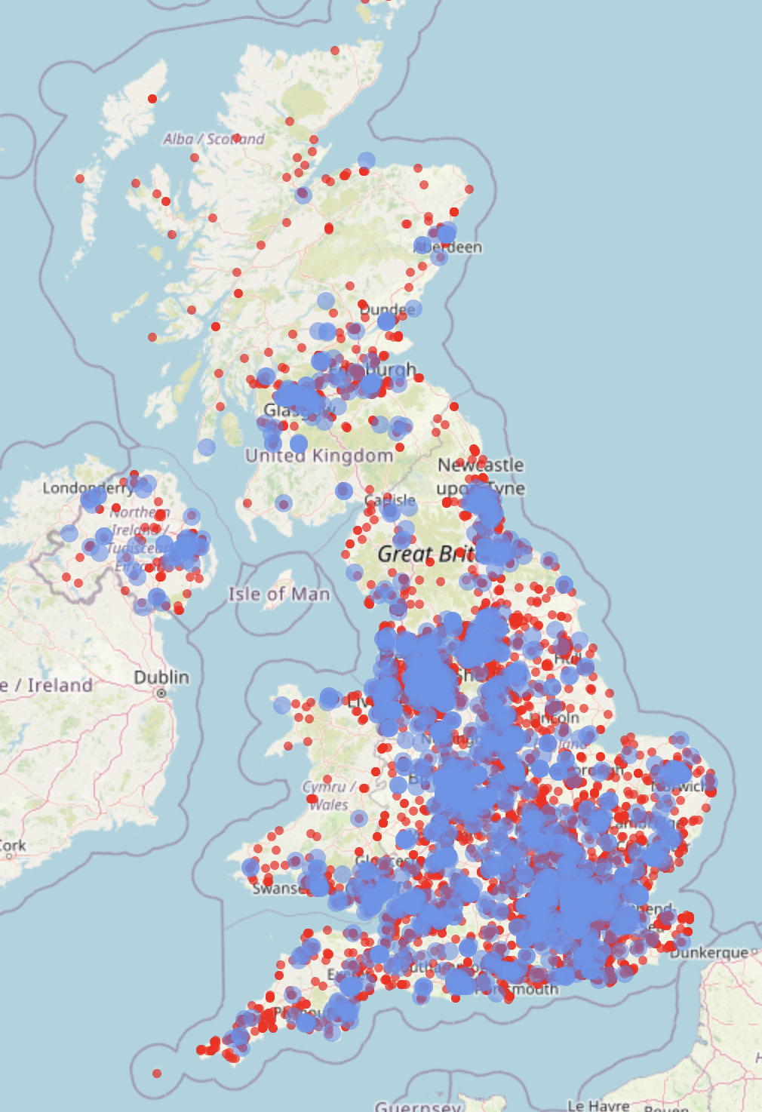
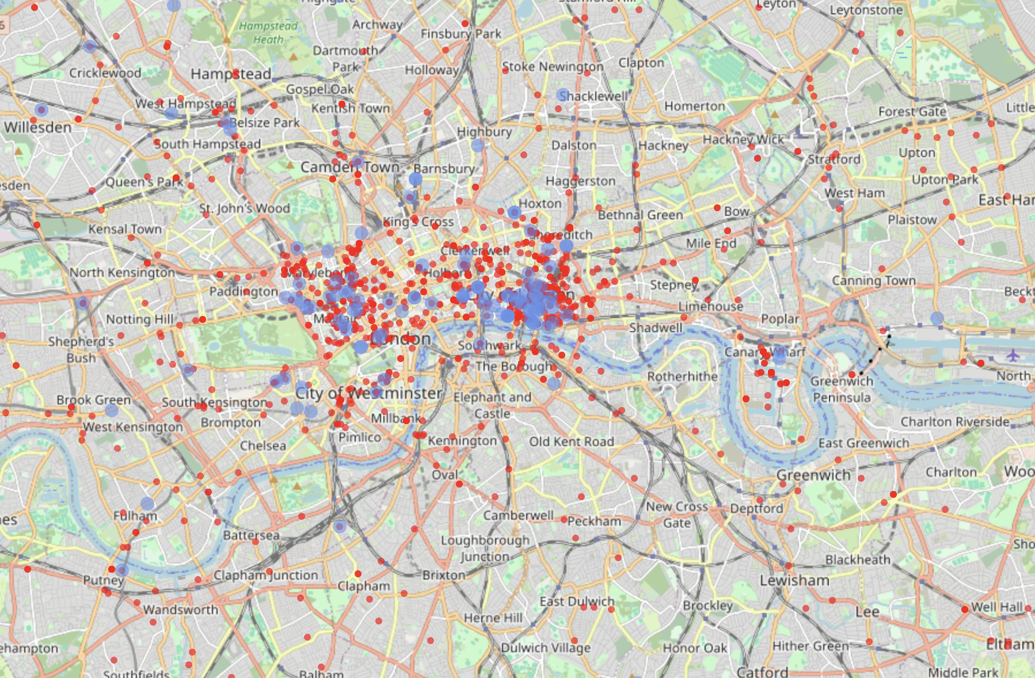
FCA registered firms

Slide 7
Methodology
Methods 3:
2. For the subcategories we applied BERTopic (Grootendorst, 2022), leveraging semantic embeddings generated by the sentence transformers in the all-MiniLM-L6-v2 model. These were reduced to vector representations with UMAP and clustered using HDBSCAN, enabling the detection of dense, thematically similar text groups. The labels were automatically generated using a text-to-text generation approach with the google/flan-t5-small model.

Slide 8
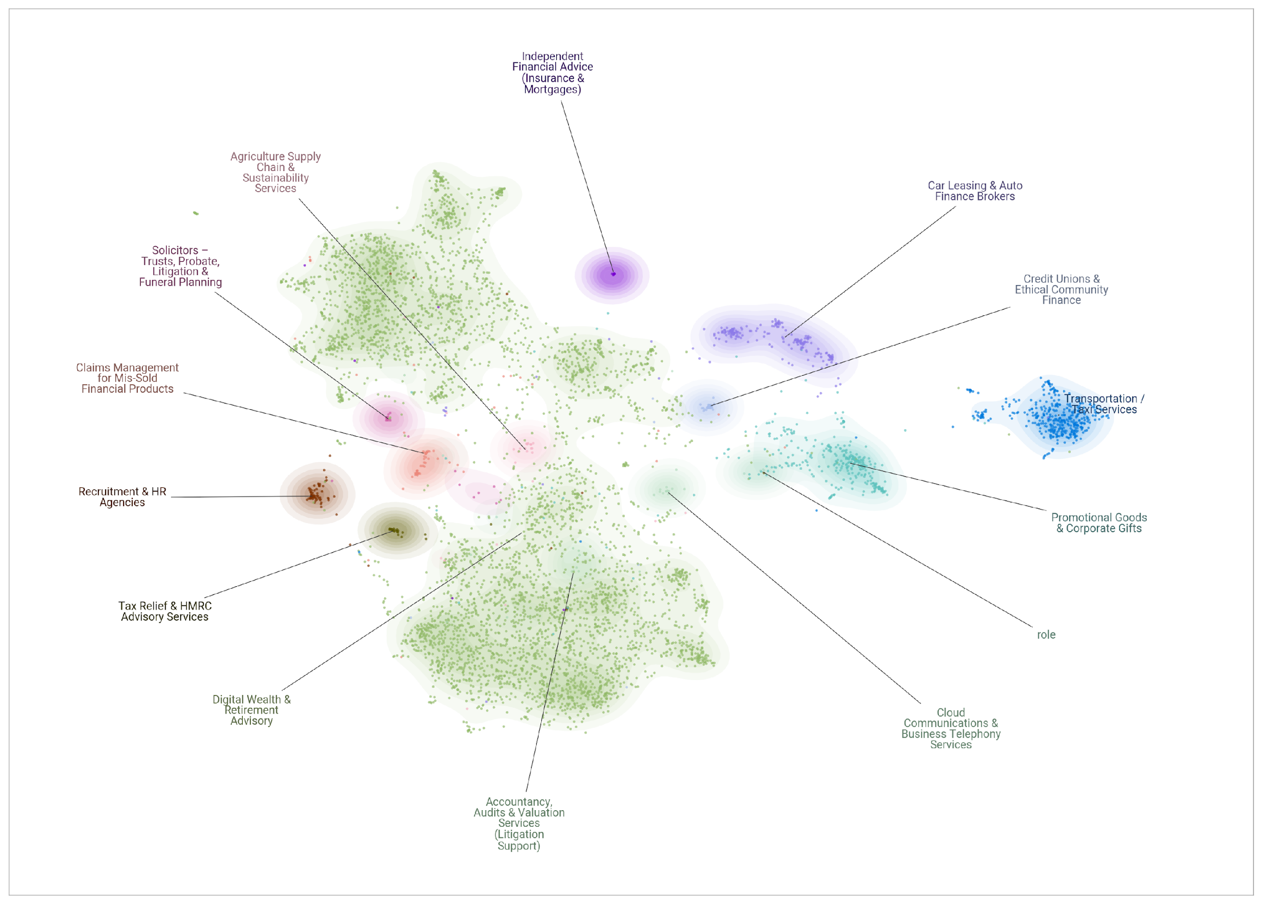
F.1 Networks only financial data before gemma 3:4b
Source: Authors' elaboration

Slide 9
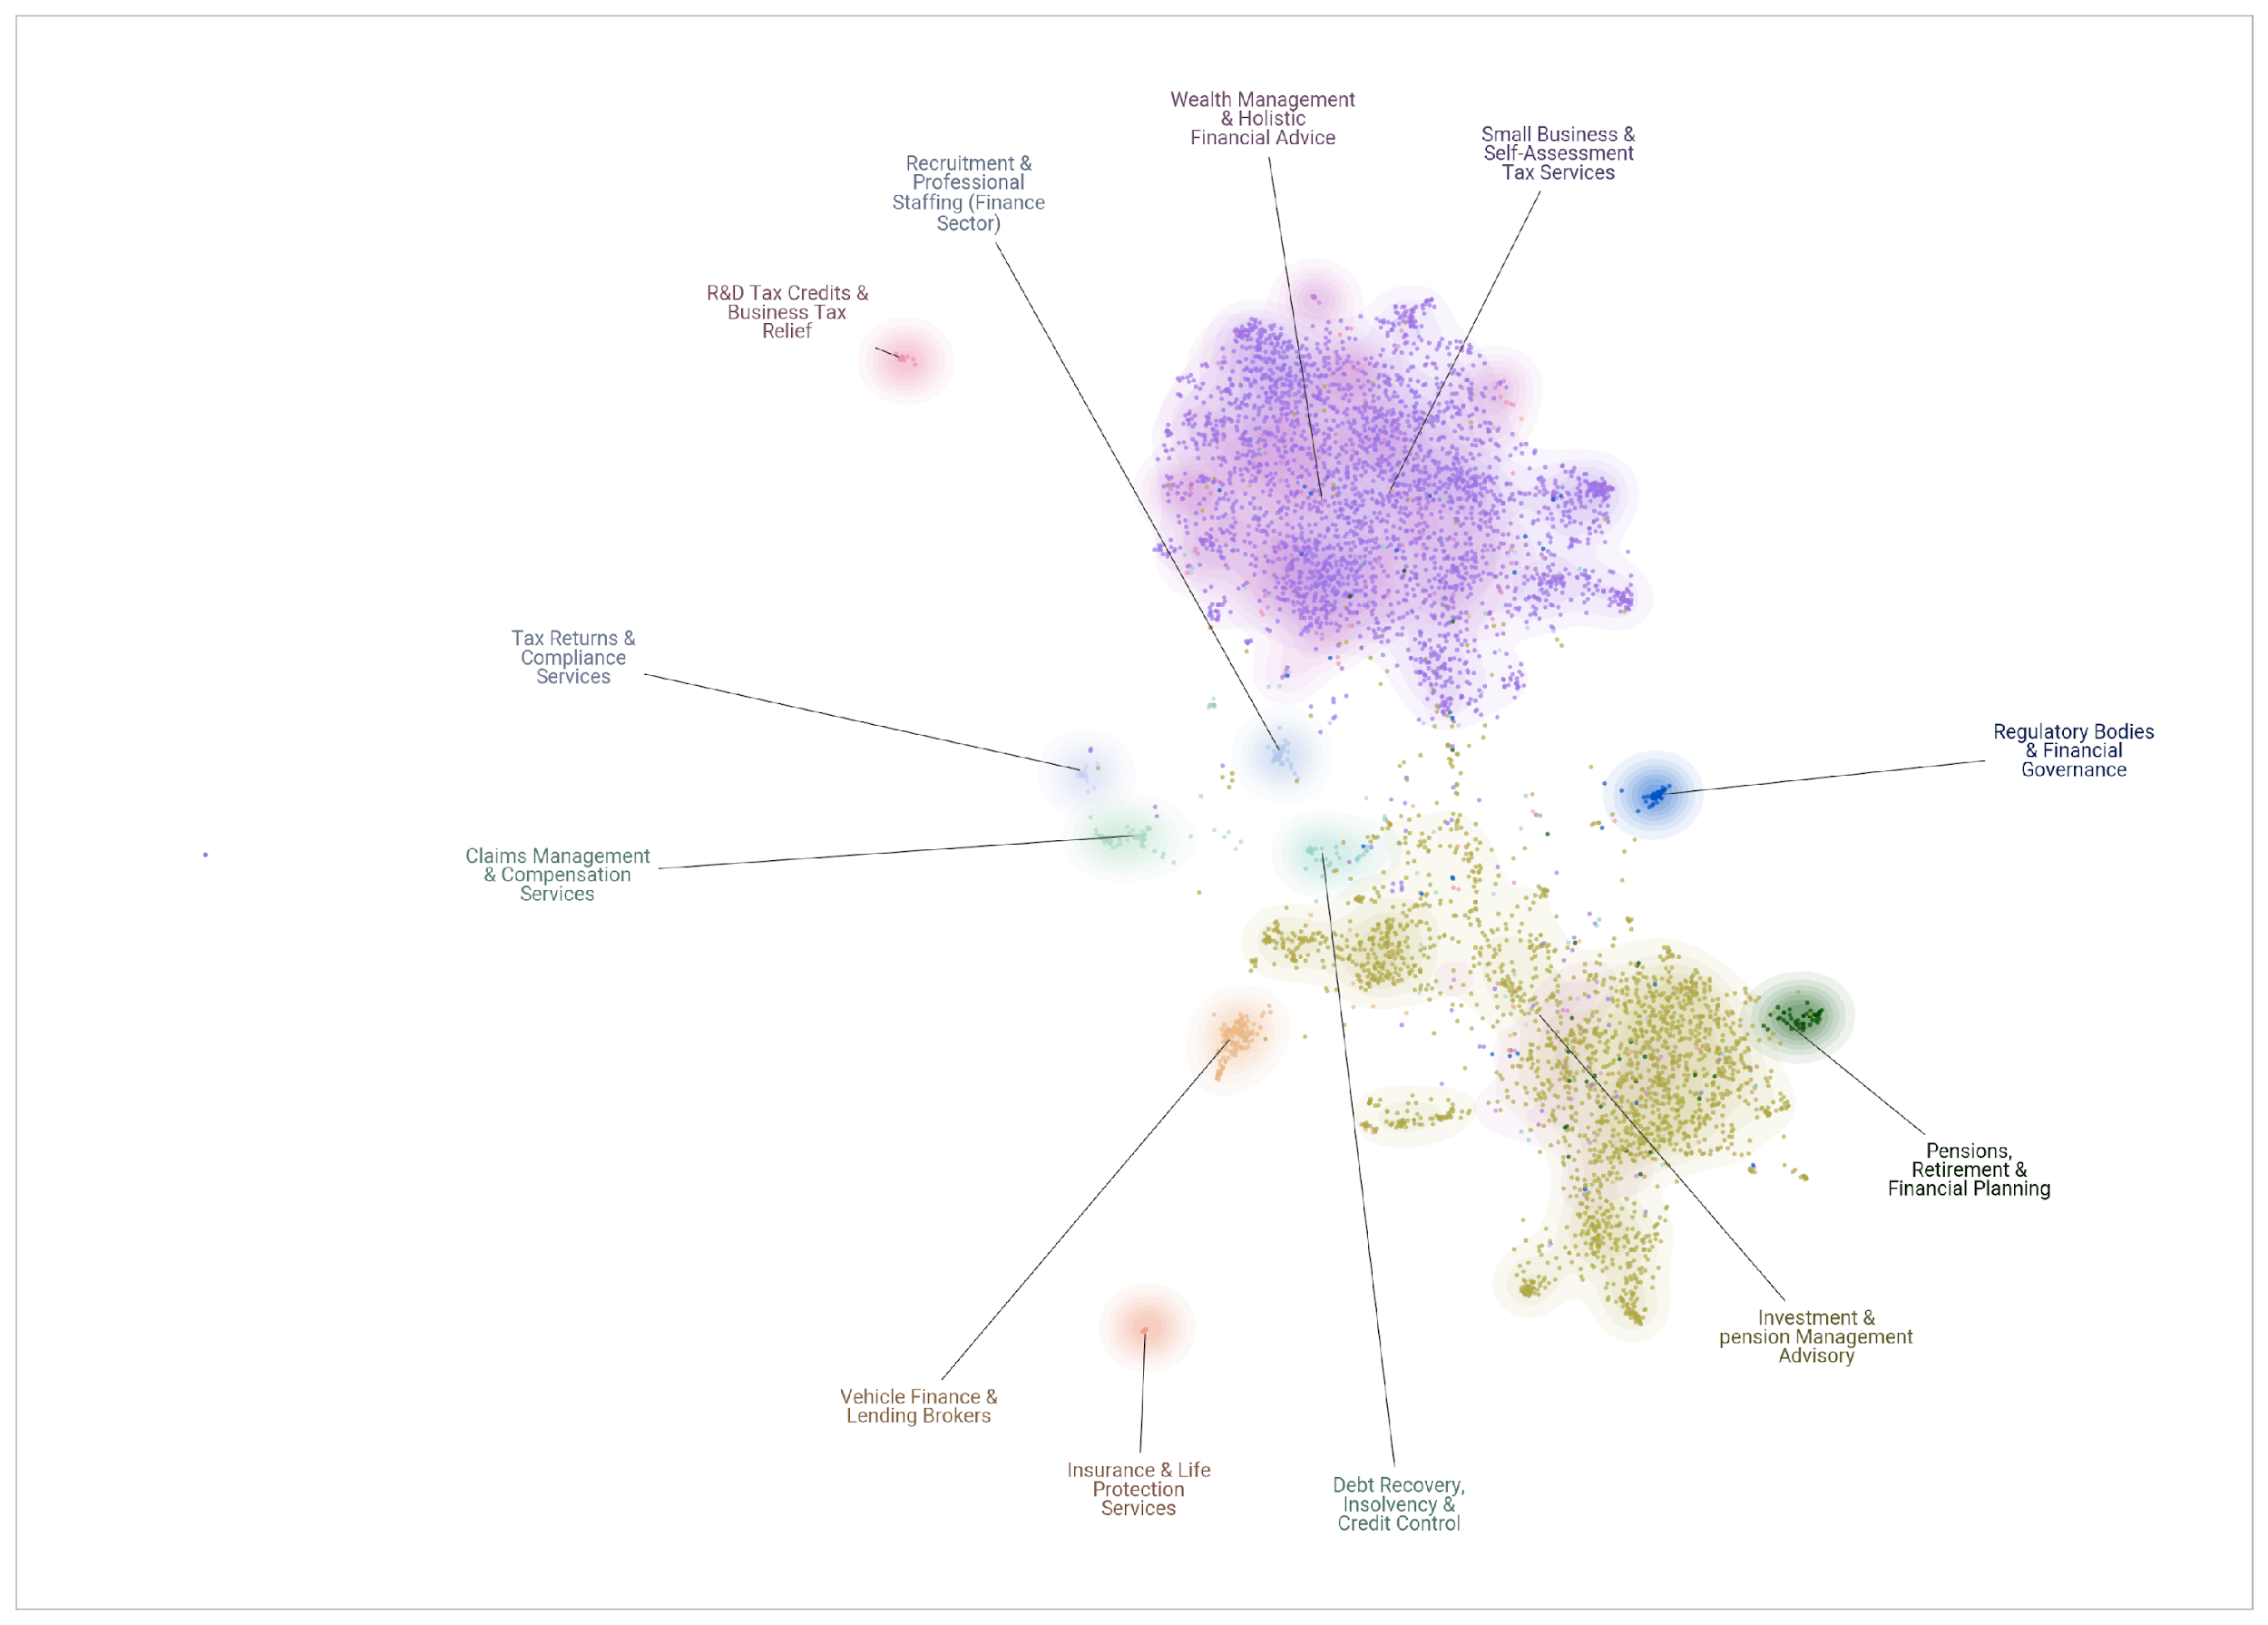
F.2 Networks only financial data after gemma 3:4b
Source: Authors' elaboration

Slide 10
Prompts
You are a strict classifier. Your job is to read the webpage content and classify the business entity into exactly one of two categories: FINANCIAL or NOT_FINANCIAL.
DEFINITIONS:
1. FINANCIAL: The core business is managing money, investments, insurance, accounting, mortgages, or providing loans.
- Includes: IFAs, Accountants, Banks, Insurance Brokers, Wealth Managers, Car Finance Brokers.
2. NOT_FINANCIAL: The core business is selling physical goods, non-financial services, hospitality, or trades.
- Includes: Retail shops, Taxis, Railways, Manufacturers, Recruitment (unless specific to finance staffing, usually NOT_FINANCIAL), Web Design.
EXAMPLES:
Text: "We offer comprehensive wealth management, pension planning, and mortgage advice to help secure your future."
Category: FINANCIAL
Text: "Welcome to A2B Taxis. We offer airport transfers, school runs, and private hire vehicles 24/7."
Category: NOT_FINANCIAL
Text: "Specialist chartered accountants providing tax returns, bookkeeping, and payroll services for small businesses."
Category: FINANCIAL
Text: "We sell trophies, medals, and offer shoe repair and key cutting services. Visit our shop today."
Category: NOT_FINANCIAL
Text: "Our steam railway offers festive trips, dining experiences, and a journey through the Highlands."
Category: NOT_FINANCIAL
INSTRUCTIONS:
Read the text below and return ONLY the category name. Do not explain.
Text to classify:
You are a strict classifier. Your job is to read the webpage content and classify the business entity into exactly one of two categories: FINANCIAL or NOT_FINANCIAL.
DEFINITIONS:
1. FINANCIAL: The core business is managing money, investments, insurance, accounting, mortgages, or providing loans.
2. NOT_FINANCIAL: The core business is everything else, including: selling physical goods, non-financial services, hospitality, or trades.
INSTRUCTIONS:
Read the text below and return ONLY the category name. Do not explain.
Text to classify:

Slide 11
Results - Few Shot(s) vs 0-Shot G3:4b
Gemma 12b model w/ examples (few shots): 459 mismatches / 14798 IDs
~3.1% mismatched against gemma 3:4b (ex)
Gemma 4b model w/o examples (zero shot): 351 mismatches / 14798 IDs
~2.3% mismatched against gemma 3:4b (ex)

Slide 12
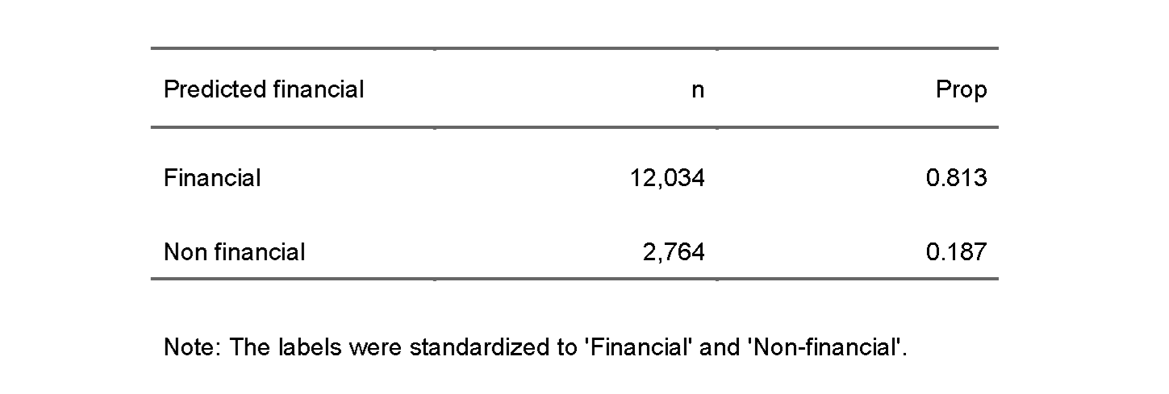
Results

Slide 13
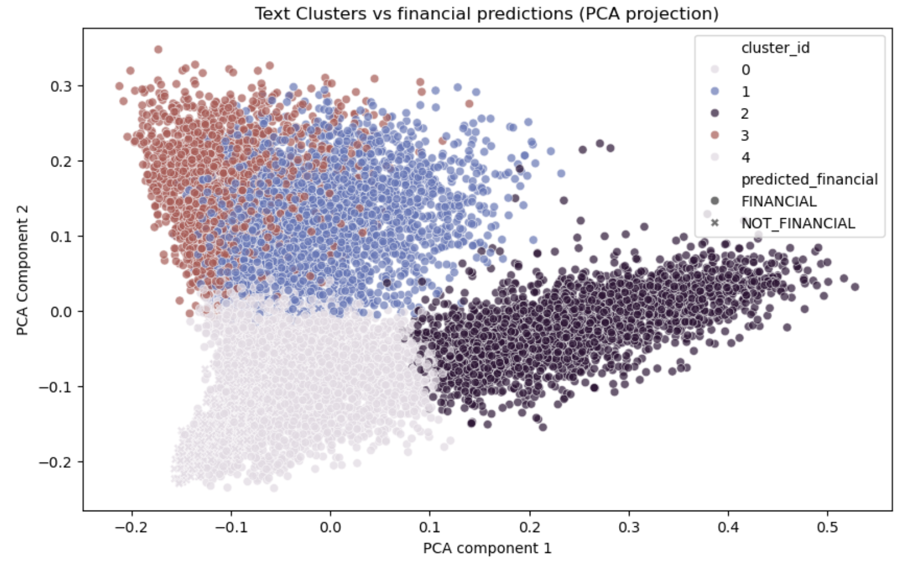
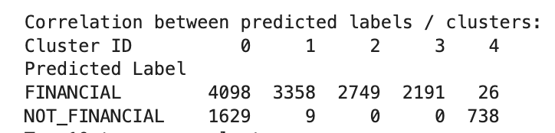
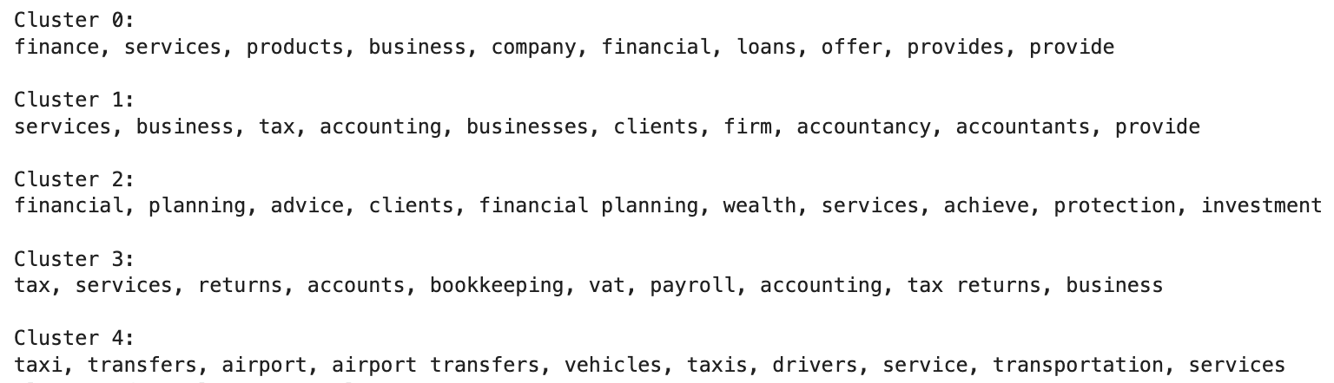
Results - R1: FINSERV vs NON-FINSERV
F.3 K-means clustering (partial) validation
Clear finance clusters? (ie, 1-3)
Confusion matrix (predicted label vs cluster):
“transport”
providers
Mysterious ~10%: too generic?
Top 10 words per cluster:
Source: Authors' elaboration

Slide 14
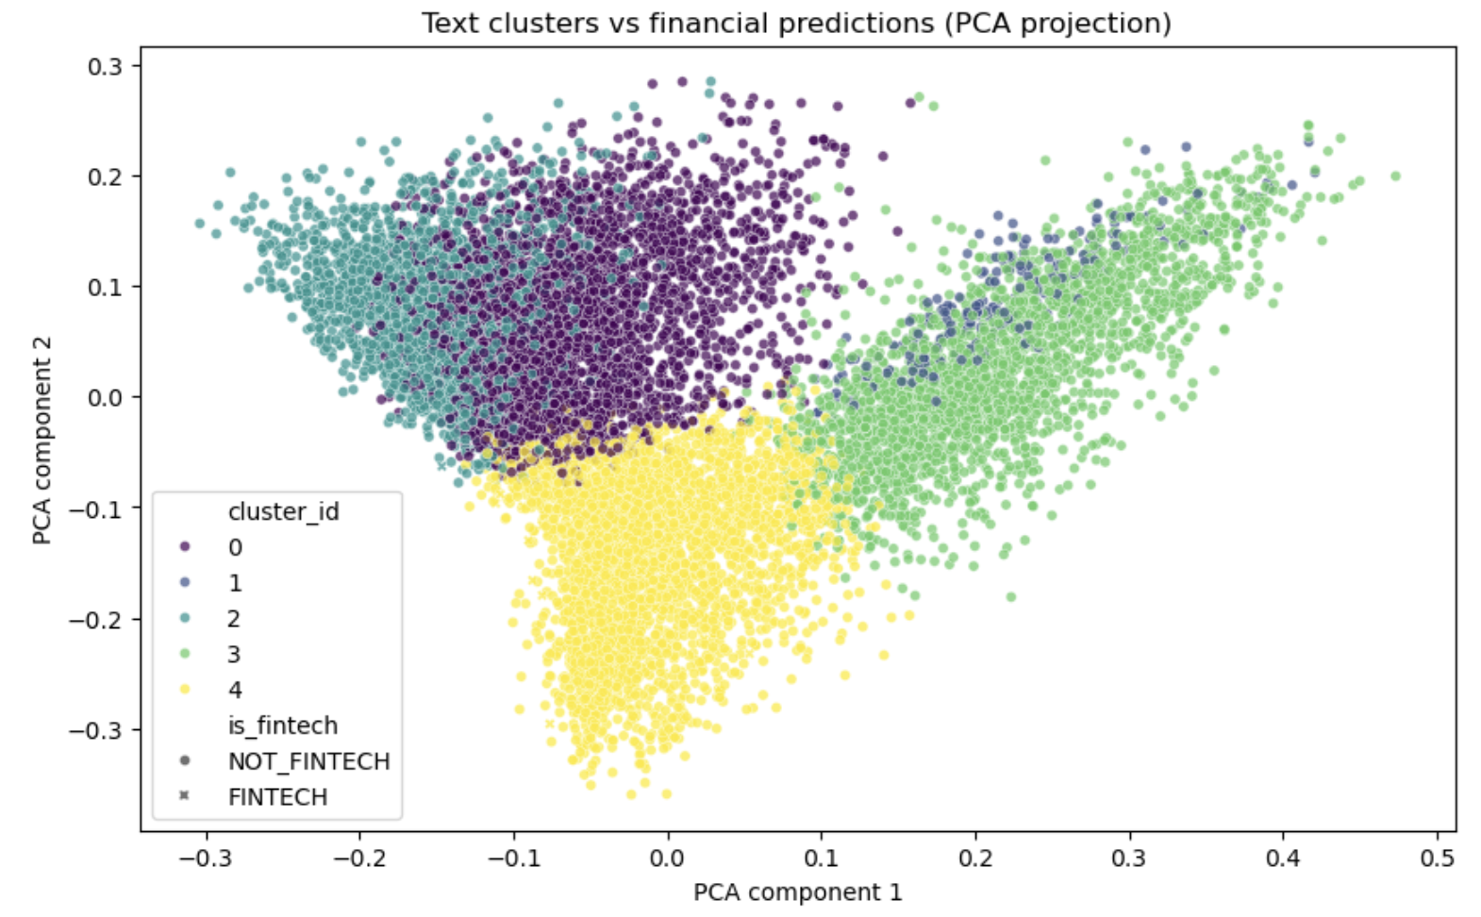
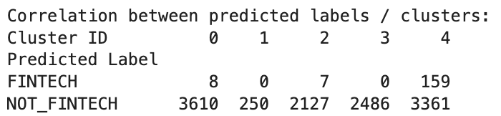
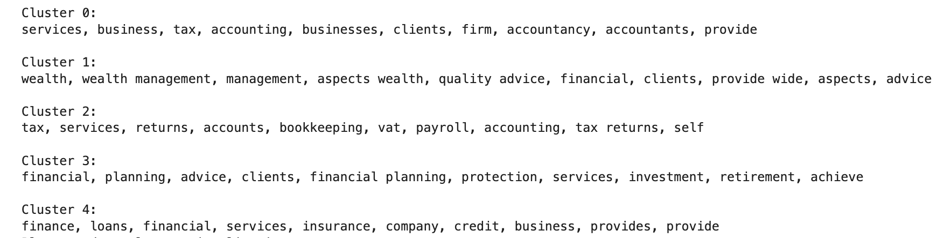
Results - R2: FINTECH vs NON-FINTECH
F.4 K-means clustering (partial) validation
Evidence of FinTech cluster? (ie, mainly 4, if so, error is ~9%)
Confusion matrix:
Top 10 words per cluster:
Source: Authors' elaboration

Slide 15
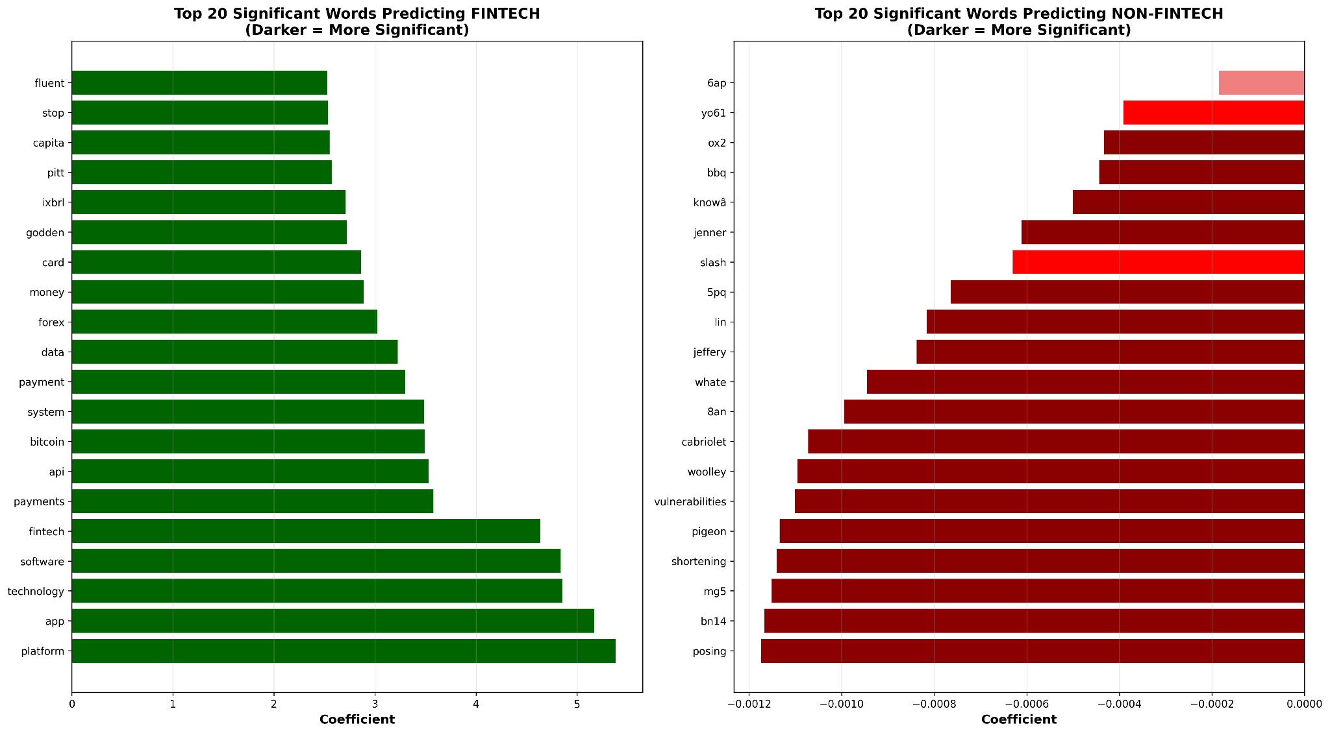
F.5 Sig vs non-sig words

Slide 16
Further research
Apply the LLM model for industrial classification of a wider array of Common Crawl data, and verify it via K-means clustering.
Classify according to yes/no questions using SIC Industrial Classification categories (Companies House, 2025).
Classification itself seems to be most effective via LLM due to the context-dependent nature of the data.

Slide 17
References
Castro Gonzalez, L., & Tranos, E. (2025, November 24). problem1_2021_finance.csv [Data set]. Retrieved from https://fluff.bris.ac.uk/
Common Crawl Foundation. (2025, November 28). Common Crawl data repository [Data set]. Retrieved from https://registry.opendata.aws/commoncrawl
Companies House. (2025, November 17). Standard industrial classification of economic activities (SIC) [Data set]. Retrieved from http://resources.companieshouse.gov.uk/sic
Gunadi, W., Lie, F., & Susanto, M. (2020). Factors contributing to the adoption of Fintech in Indonesia. Psychology and Education, 57(9), 284–291. Retrieved from www.psychologyandeducation.net
Hodson, D. (2021). The politics of FinTech: Technology, regulation, and disruption in UK and German retail banking. Public Administration, 99(4), 859–872. https://doi.org/10.1111/padm.12731

Slide 18
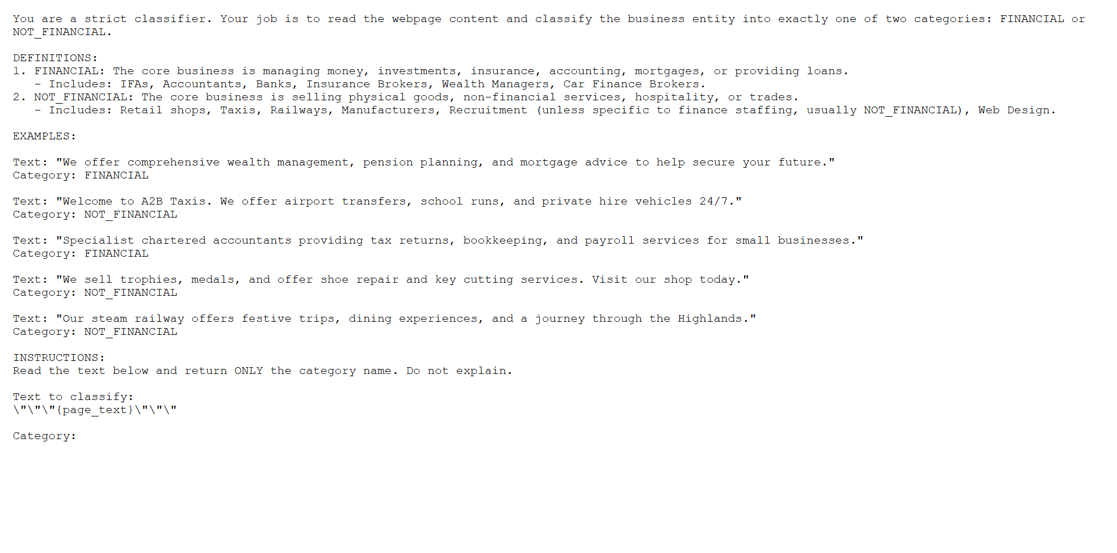
Annex 1
Prompt-base for LLM analysis

